Slide 1
Codein First Demo
Alla, Sreedhar, Maryam, Youhao, Zack

Slide 2
Functionality
Create User Account
Login
Used an adds-on to implement the user registration and login functionality.
pip install django-rest-auth pip install djangorestframework-jwt pip install django-allauth

Slide 3
API Installment on back-end
The REST API has been created on top of AWS instance.
Three different API function calls have been created for the different functionality we are currently implementing.
API Function Calls
Creating Account
HTTP POST 34.203.190.77:8080/rest-auth/registration
Username: ""
Password1: ""
password2: ""
Returns: Json token for continued authentication.
Login
HTTP POST 34.203.190.77:8080/rest-auth/login/
username: ""
password: ""
Returns: JSON token for continued authentication.
Logout
HTTP POST 34.203.190.77:8080/rest-auth/logout/
Returns: A success message.

Slide 4
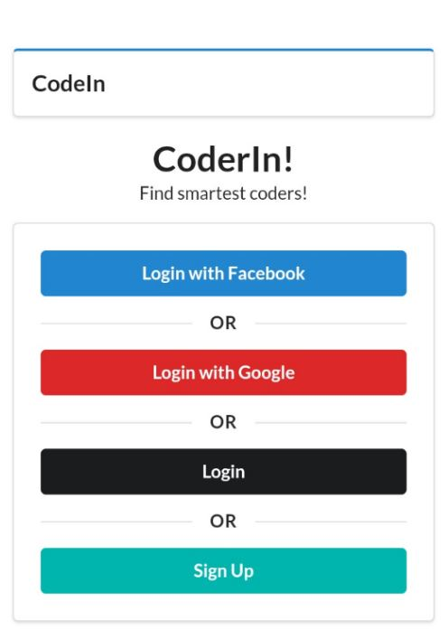
The homepage of the Codein website

Slide 5
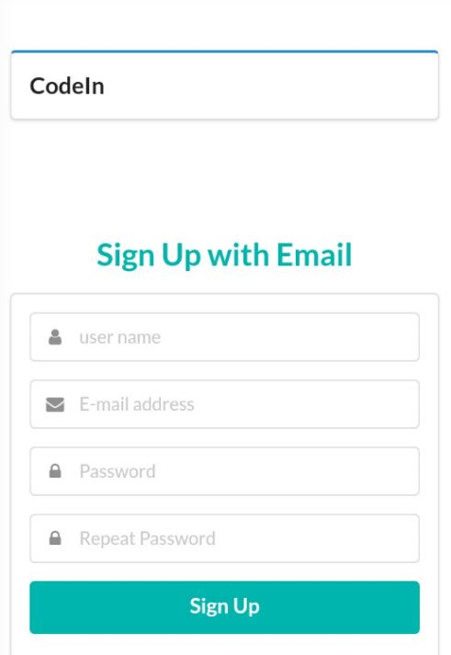
Signing up with Django original auth adds-on

Slide 6
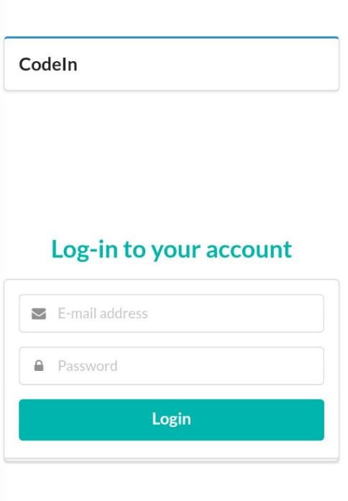
Logining in to the Codein Website

Slide 7
Thank You

